Slide 1
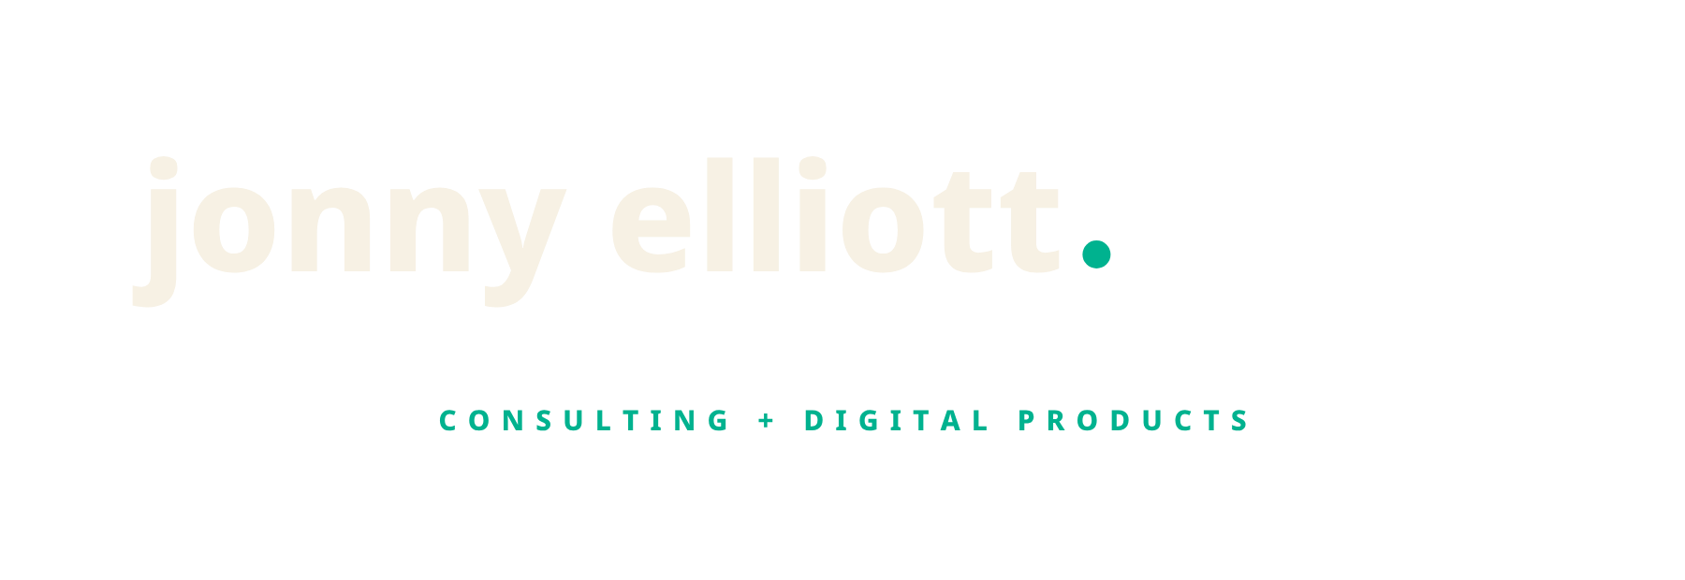
What I do,
and what it costs.
Eight ways to work with me, with the price written on every one of them.
jonnyelliott.com
Notes:
Open with the point rather than the name: he stops owners being the bottleneck. The prices being public is the thing people remember.

Slide 2
The problem
I help people who run small businesses stop being the thing everything waits on.
The week is a run of small emergencies.
Everything routes through you, so nothing moves while you are not at the desk.
The work that would change the business never starts.
Because the work that keeps it alive never stops.
Nothing is written down.
Which is why the second person you hire still cannot take a job off you.
Notes:
Three symptoms, not three problems. They are all the same problem.

Slide 3
Fit
Who this is for, and who it is not.
It fits
It does not
Two to fifty people.
Looking for a marketing agency.
Owner still in most of the decisions.
Wants a plan rather than a change.
Making money, or close to it.
Pre revenue, looking for a co founder.
Willing to change how a Tuesday is spent.
Mainly wants agreeing with.
Notes:
He turns work down. That is the reason it is worth putting your name to.

Slide 4
One
Things you can run
on your own.
Nothing here needs an hour of my time to start working. The cheap end, and for a fair number of people the right end.
Notes:
Fifty pounds a month is a real product, not a lead magnet. Twenty pounds of commission on it, and the same person often buys something larger later.

Slide 5
One
Software, and somebody looking after the site.
Both are rolling, both cancel whenever, and neither one needs a call to start.
ElliottOS
£50 a month
Website care
£75 a month
A week that runs itself
Never think about your website again
One connected system that runs your whole life and work: Alfred, six orbits, the daily loop, the systems library and a private vault. It comes free with every consulting tier.
Hosting, updates, backups, monitoring and small changes. If something breaks it is fixed before you notice, and if you want a paragraph changed you send me a message rather than finding somebody.
ElliottOS is included free with every consulting tier. Website care is included for the first three months of any build.

Slide 6
Two
Things I build
for you.
A fixed scope, a fixed price and an end date. You get the thing, and you get the files and the logins that go with it.
Notes:
Fifteen per cent on a build is the biggest single commission in the scheme.

Slide 7
Two
A site, or the system itself.
Both are yours to keep. If we stop working together the business does not lose anything it was running on.
Website and brand
From £2,500
The Ninety Day Build
£6,000
A site that brings work in
The system, built, with an end date on it
Market research, copywriting, the build, brand identity, search groundwork and your own client portal. Five weeks, done for you.
Ninety days, fortnightly, to build the system your business runs on and get the first three things off you. Fixed scope, fixed end date, and everything we write is yours. This is Runs Without You at pace, with a finish line.
A build is half up front and half when you have seen it. If the design is not right, say so and there is no balance to pay.

Slide 8
Three
Working
with me.
A standing call, a plan you are held to, and somebody who has seen this before and has no reason to flatter you.
Notes:
Fifty per cent of the first two months, released as each month is collected.

Slide 9
Three
The two most people start on.
Rolling, no notice period, nothing to sign. ElliottOS is included in both.
Stop Firefighting
£500 a month
Get It Built
£1,000 a month
A week that stops being a series of emergencies
The thing you have meant to do for a year, finally done
One 60 minute call a month with a clear focus, a guided twelve month programme, and replies within 48 hours between sessions. For founders who are operationally solid and want an independent view.
Two calls a month, a focus session and a working session, with a five area pulse so the whole business stays in view. A Life Audit, replies within 24 hours, and a check in between calls.
Come to the first session. If you do not leave it with one thing worth more than the month costs, do not pay for the month.

Slide 10
Three, continued
The two heavier ones.
Both change how the business runs rather than how you think about it.
Runs Without You
£1,500 a month
Inside
£3,500 a month
A business that keeps going while you are not in it
Me in the business, not next to it
Two calls a month, one strategic and one where the system gets built, and everything in between written down rather than talked about: a custom operating system across business and life, yours to keep. Quarterly reviews, priority replies, and days in person at Knutsford.
A day a week, in the business rather than advising it. I take a function, run it, hire into it, and hand it back working. Two clients at a time, and usually a fixed piece of work rather than something open ended.
Inside has two places and they are not often free. Runs Without You is what most people do in the meantime.

Slide 11
The whole list
Everything, with the price on it.
No call needed to find out. All of it is on jonnyelliott.com/shop as well.
ElliottOS
Software you run yourself
£50 a month
Website care
Hosting, updates, backups and small changes
£75 a month
Stop Firefighting
One call a month, and somebody honest in your corner
£500 a month
Get It Built
Two calls a month, and the thing finally gets built
£1,000 a month
Runs Without You
The system written down, and starting to run without you
£1,500 a month
Website and brand
Research, copy, brand, build and your own portal
From £2,500
The Ninety Day Build
Ninety days, fixed scope, fixed finish line
£6,000
Inside
A day a week, in the business rather than advising it
£3,500 a month

Slide 12
The promise
Every one of these can be stopped by you, early, at no cost.
Not a refund window buried in terms. A specific moment, written down before you pay.
The consulting tiers
Come to the first session. If it is not worth more than the month costs, do not pay for the month.
A website build
Half up front, half when you have seen it. If the design is not right, no balance to pay.
The Ninety Day Build
If the first fortnight has not earned its keep, stop there and the rest does not happen.
Inside
The first month decides it. If you would rather I was not in the business, we stop.
Anything digital
If it does not do what the page said, I refund it. That offer does not run out.

Slide 13
What happens after you buy
Your portal opens the same minute.
Everything he sells is used through your own client portal, whether you have spent six thousand pounds or nothing at all.
1
2
3
Open your account
Choose from inside it
It all lands in one place
Your name and your email, and that is the whole form. Your login is in your inbox before you have closed the tab. Nothing is charged at this point.
Every price and what it asks of you sits on the product itself. Card for anything small and monthly, an invoice for a build.
Your project and where it has got to, your documents, what you have bought, and a short list of what is waiting on you.

Slide 14

Where to start.
If you already know which one you want, open an account and buy it from inside. If you do not, book the call and he will tell you which of these you need, including when the answer is none of them.
jonnyelliott.com/shop for the whole list and the prices
jonnyelliott.com/book for twenty minutes with him
Notes:
If you are showing this as an introducer: send them your own link rather than the plain address, so the introduction is attributed to you.

